Slide 1
CS471/571
Ch 2 Software Life Cycle Models

Slide 2
Outline
Software development in theory and practice
Iteration and incrementation
Other life-cycle models
Comparison of life-cycle models

Slide 3
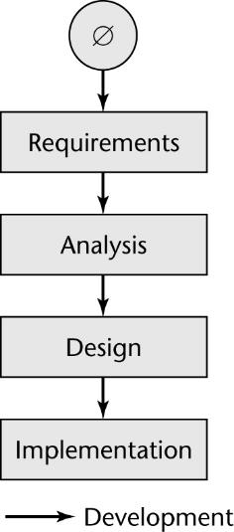
Software Development in Theory
Ideally, software is developed
Linear
Starting from scratch

Slide 4
Software Development in Practice
In the real world, it is totally different
We make mistakes
The client’s requirements change while the software product is being developed

Slide 5
The Winburg Mini Case Study
Episode 1: The first version is implemented
Episode 2: A fault is found
The product is too slow because of the fault
Changes to the implementation are begun
Episode 3: A new design is adopted
A faster algorithm is used
Episode 4: The requirements change
Accuracy has to be increased
Epilogue: A few years later, these problems recur

Slide 6
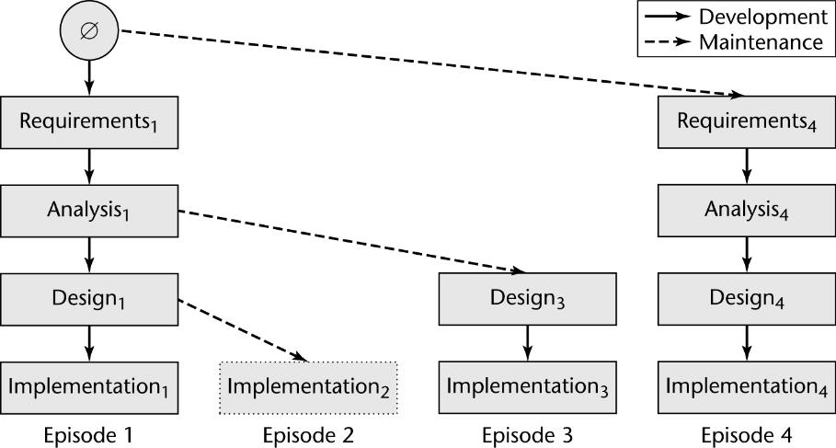
Evolution-Tree Model

Slide 7
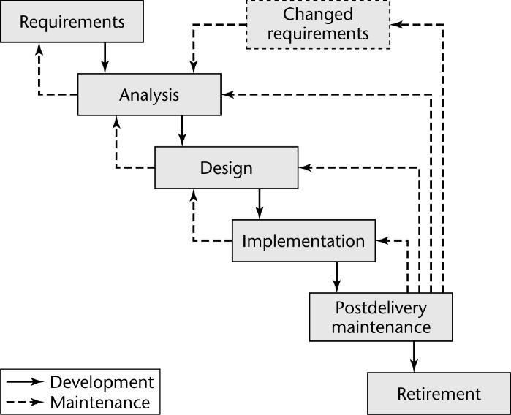
Waterfall Model

Slide 8
Waterfall Model (contd)
Characterized by
Linear life cycle model with feedback loops
Documentation-driven
Advantages
Straightforward
Documentation makes maintenance easier
Disadvantages
It cannot show the order of events
Testing vs other activities?
Iteration?

Slide 9
Return to the Evolution-Tree Model
The explicit order of events is shown
At the end of each episode
We have a baseline, a complete set of artifacts (constituent components)
Example:
Baseline at the end of Episode 3:
Requirements₁, Analysis₁, Design₃, Implementation₃
Real world development is more chaotic
Changes are always needed

Slide 10
Teal Tractors Mini Case Study
While the Teal Tractors software is being constructed, the requirements change
The company is expanding into Canada
Changes needed:
Additional sales regions must be added
Canadian taxes and other business aspects are handled differently
Two different currencies: USD and CAD
The changes may be great for the company
But disastrous for the software product

Slide 11
Moving Target Problem
A change in the requirements while the software product is being developed
Even if the reasons are good, the software product can be adversely impacted
Change can potentially cause a regression fault
If there are too many changes, the entire product may have to be redesigned and re-implemented.
Change is inevitable
Growing companies are always going to change
If the individual calling for changes has sufficient clout, nothing can be done about it

Slide 12
Iteration and Incrementation
In real life, we cannot speak about “the analysis phase”
Instead, the operations of the analysis phase are spread out over the life cycle
The basic software development process is iterative
Each successive version is intended to be closer to its target than its predecessor

Slide 13
Complexity: Miller’s Law: 7 ± 2
At any one time, we can concentrate on approximately seven chunks (units of information)
# of units a programmer must process to understand a complex decision is f(2^{n})
n is the number of conditions in the decision.
How many alternatives to comprehend does an If/Else nest 3 levels deep have?
What about 4 levels?

Slide 14
Miller’s Law: 7 ± 2 - cont
To handle larger amounts of information, use stepwise refinement
Concentrate on the aspects that are currently the most important
Postpone aspects currently less critical
Every aspect is eventually handled, but in order of current importance
This is an incremental process

Slide 15
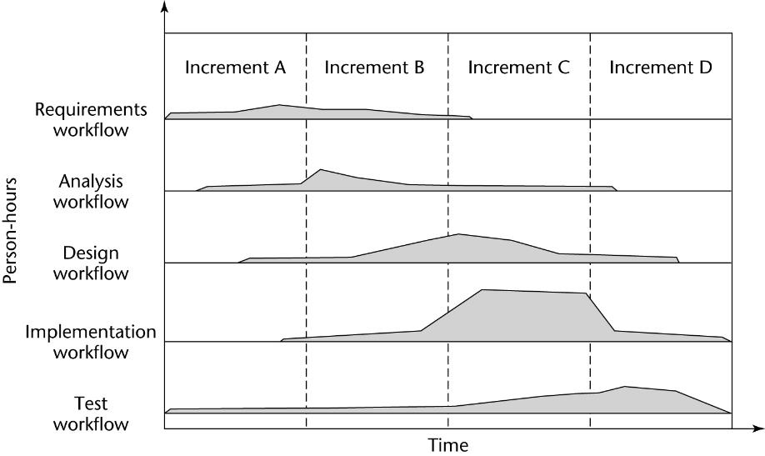
Iteration and Incrementation (contd)
Figure 2.4
Notes:
Increments A, B, C, D can be new features or new phases. The unified process has four phases: inception, elaboration, construction, and transition.

Slide 16
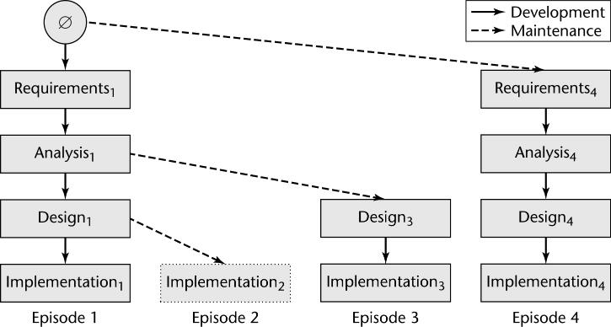
Iteration and Incrementation (contd)
Iteration and incrementation are used in conjunction with one another
No single “requirements phase” or “design phase”
Instead, there are multiple instances of each phase

Slide 17
Sequential Phases versus Workflows
No sequential phases in the real world
Instead, the five core workflows (activities) are performed over the entire life cycle
Requirements workflow
Analysis workflow
Design workflow
Implementation workflow
Test workflow

Slide 18
Workflows
At most times, one workflow predominates
At the beginning of the life cycle
The requirements workflow predominates
At the end of the life cycle
The implementation and test workflows predominate
Planning and documentation activities are performed throughout the life cycle

Slide 19
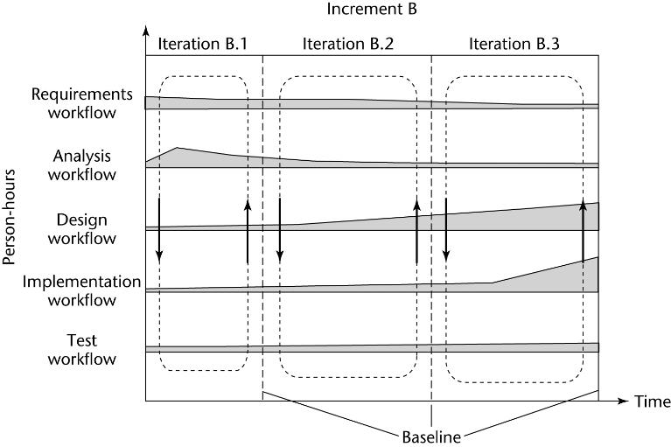
Iteration and Incrementation (contd)
Iteration is performed during each incrementation

Slide 20
The Winburg Mini Case Study Revisited
Consider the next slide
The evolution-tree model has been superimposed on the iterative-and-incremental life-cycle model
The test workflow has been omitted — the evolution-tree model assumes continuous testing

Slide 21
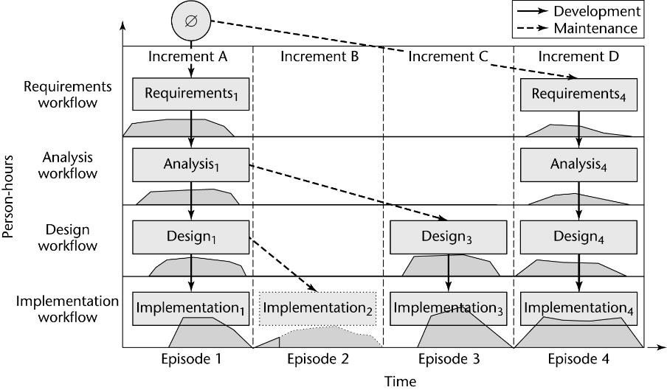
The Winburg Mini Case Study Revisited
Notes:
Episodes 2, 3: Corrective maintenance
Episode 4: Perfective maintenance

Slide 22
Other Aspects of Iter. and Increm.
We can consider the project as a whole as a set of mini projects (increments)
Each mini project extends the
Requirements artifacts
Analysis artifacts
Design artifacts
Implementation artifacts
Testing artifacts
The final set of artifacts is the complete product

Slide 23
Other Aspects of Iter. and Increm. (contd)
During each mini project we
Extend the artifacts (incrementation);
Check the artifacts (test workflow); and
If necessary, change the relevant artifacts (iteration)
Each iteration can be viewed as a small but complete waterfall life-cycle model
During each iteration we select a portion of the software product

Slide 24
Strengths of the Iterative-and-Incremental Model
Multiple opportunities for checking that the software product is correct
Every iteration incorporates the test workflow
Faults can be detected and corrected early
The robustness of the architecture can be determined early in the life cycle
Architecture — the various component modules and how they fit together
Robustness — the property of being able to handle extensions and changes without falling apart

Slide 25
Strengths of the Iterative-and-Incremental Model (contd)
We have a working version of the software product from the start
The client and users can experiment with this version to determine what changes are needed
Variation: Deliver partial versions to smooth the introduction of the new product in the client organization
We can mitigate (resolve) risks early
Risks are invariably involved in software development and maintenance

Slide 26
Risks in Development & Maintenance
A complete project will not meet its time constraints
Current hardware is inadequate
Key personnel can resign before the product has been adequately documented
The hardware manufacturer can go bankrupt
The components may not fit together when integrated
Technological breakthroughs can render the entire product worthless
A competitor may announce a lower-priced but similar product
…

Slide 27
Other Life-Cycle Models
Code-and-fix life-cycle model
Rapid prototyping life-cycle model
V Model
Open-source life-cycle model
Synchronize-and-stabilize life-cycle model
Spiral life-cycle model
Agile processes

Slide 28
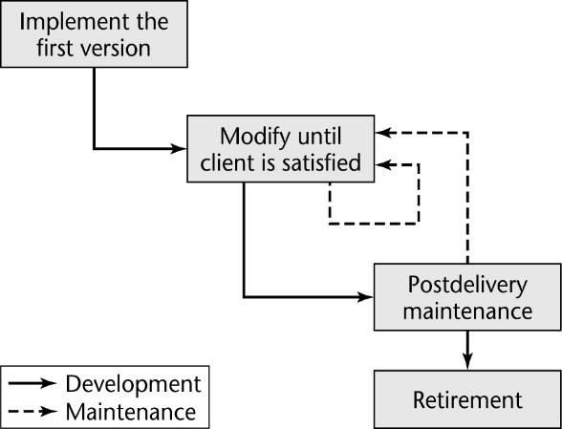
Code-and-Fix Model
No design
No specifications
Maintenance nightmare
The “easiest” way The most expensive way

Slide 29
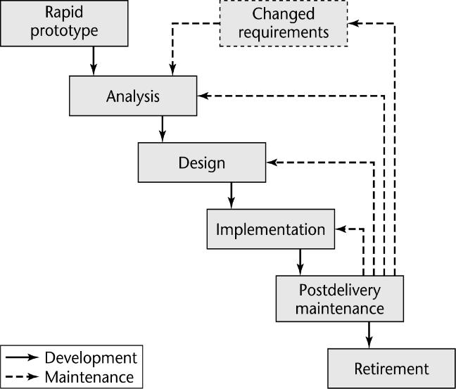
Rapid Prototyping Model
Linear
“Rapid”
A rapid prototype is a working model that is functionally equivalent to a subset of the product.

Slide 30
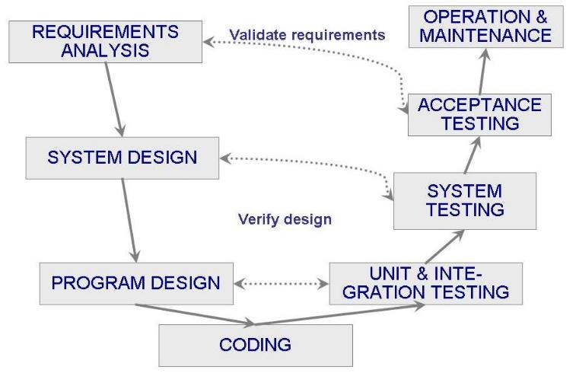
V Model

Slide 31
V Model - cont
A variation of the waterfall model that demonstrates how the testing activities are related to analysis and design
Unit testing to verify procedural design
Integration testing to verify architectural design
Acceptance testing to validate the requirements
If problems are found during v&v, the left side of the V can be re-executed before testing on the right side is re-enacted

Slide 32
Open-Source Life-Cycle Model
Two informal phases
First, one individual builds an initial version
Made available via the Internet (e.g., SourceForge.net)
Then, if there is sufficient interest in the project
The initial version is widely downloaded
Users become co-developers
The product is extended
Key point: Individuals generally work voluntarily on an open-source project in their spare time

Slide 33
The Activities of the 2nd Informal Phase
Reporting and correcting defects
Corrective maintenance
Adding additional functionality
Perfective maintenance
Porting the program to a new environment
Adaptive maintenance
The second informal phase consists solely of postdelivery maintenance
The word “co-developers” on the previous slide should rather be “co-maintainers”

Slide 34
Open-Source Life-Cycle Model (contd)
Closed-source software is maintained and tested by employees
Users can submit failure reports but never fault reports (the source code is not available)
Open-source software is generally maintained by unpaid volunteers
Users are strongly encouraged to submit defect reports

Slide 35
Open-Source Life-Cycle Model (contd)
Core group
Small number of dedicated maintainers with the inclination, the time, and the necessary skills to submit fault reports (“fixes”)
They take responsibility for managing the project
They have the authority to install fixes
Peripheral group
Users who choose to submit defect reports from time to time

Slide 36
Open-Source Life-Cycle Model (contd)
In an open-source project, there are generally no specifications and no design.
How have some open-source projects been so successful without specifications or designs?
It can be extremely successful for infrastructure projects, such as
OS (Linux, OpenBSD)
Compilers (gcc)
Web browsers (Firefox) , Web servers (Apache)
Database management systems (MySQL)
Notes:
Open-source software production has attracted some of the world’s finest software experts. They can function effectively without specifications or designs
However, eventually a point will be reached when the open-source product is no longer maintainable

Slide 37
Microsoft’s Synchronize-and Stabilize Model
Requirements analysis
Interview potential customers
A specification is drawn up
Work is divided into 3 or 4 builds (milestone junctures/sequential sub-projects)
1st build: most critical features
2nd build: next most critical features
Each build is carried out by small teams working in parallel
Cusumano, Michael A.,; Selby, Richard W. Synchronize-and-stabilize : an approach for balancing flexibility and structure in software product development
Notes:
Originally, David Yoffie of Harvard University and Michael Cusumano of MIT studied the commonalities between processes Microsoft used in developing Internet Explorer and those Netscape Communications Corp. used in developing Netscape Communicator.

Slide 38
Synchronize-and Stabilize Model (contd)
Synchronize at the end of the day
Integrate the partially completed components
Test and debug
Get early insights into the operation of product
Stabilize at the end of the build
Defects are fixed
Freeze the build

Slide 39
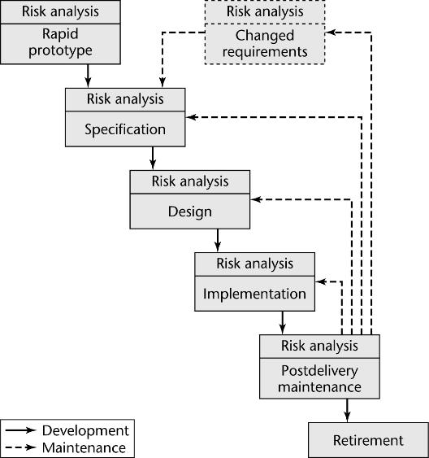
Spiral Model
Simple form: Rapid prototyping plus risk analysis
Proof-of-concept prototype (a scale model) to test the feasibility
If all risks cannot be mitigated, the project is immediately terminated

Slide 40
Full Spiral Model
Each phase is a cycle of the spiral
Determine objectives, alternatives, and constraints
Evaluate alternatives, identify/mitigate risks
Sometimes build a prototype
Develop, verify next-level product
Planning of the next phase

Slide 41
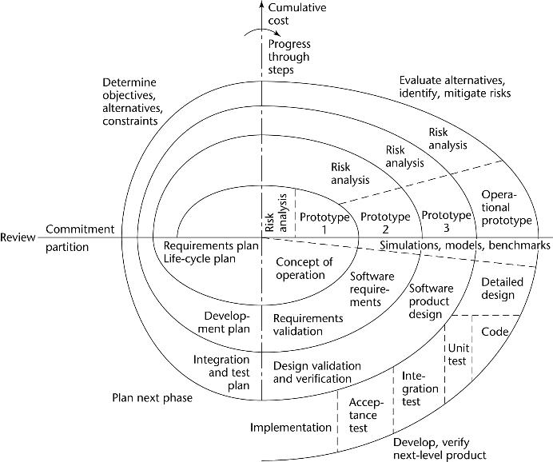
Full Spiral Model (contd)
Notes:
Radial dimension: cumulative cost to date;
Angular dimension: progress through the spiral;
Each circle (phase) begins in the top-left quadrant;

Slide 42
Analysis of the Spiral Model
Strengths
It is easy to judge how much to test
No distinction is made between development and maintenance
Weaknesses
For large-scale software only
For internal (in-house) software only
Risk-driven can be a strength and weakness
Skilled at pinpointing and analyzing risks accurately

Slide 43
Comparison of Life-Cycle Models
Different models have been presented
Each with its own strengths and weaknesses
Criteria for deciding on a model include:
The organization
Its management
The skills of the employees
The nature of the product
Best suggestion
“Mix-and-match” life-cycle model

Slide 44
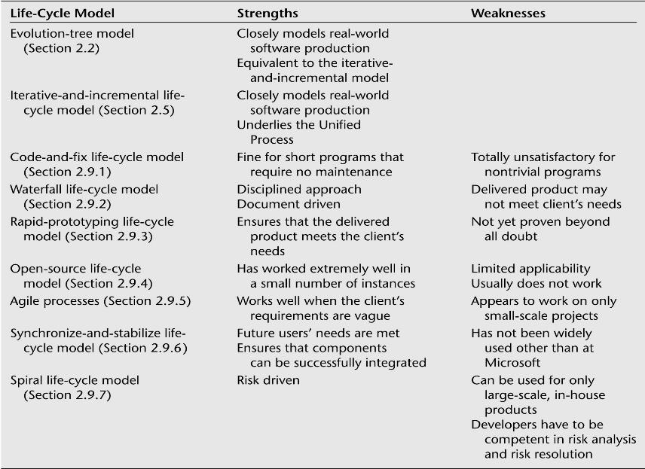
Comparison of Life-Cycle Models (contd)

